Slide 1

Root Cause Analysis
An overview of Root Cause Analysis and its applications
December 10, 2020

Slide 2
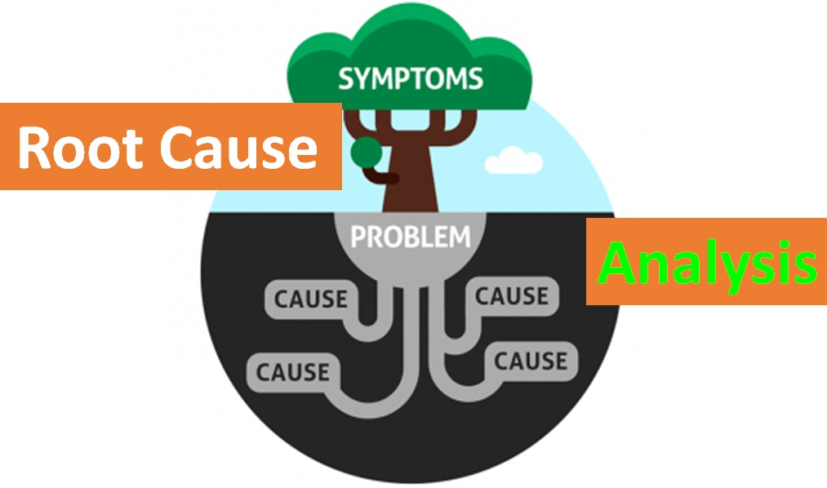
Executive Summary
Root Cause Analysis is an approach for identifying the underlying causes and identifying effective solutions.
Problem solving, incident investigation and root cause analysis are all fundamentally connected by three basic questions:
  What's the problem?
  Why did it happen?
  What will be done to prevent it?

Slide 3
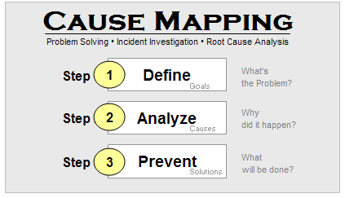
Cause Mapping
A Cause Map can provide a simple visual explanation of all the causes that were required to produce the incident.
The root is the system of causes that reveals all of the different options for solutions.

Slide 4

Using a Cause Map
So how do we build a cause map?
Start on the left. Read to the right saying "was caused by" in place of the arrows. Investigating a problem begins with the problem and then backs into the causes by asking Why questions.
Problem: The report was sent late.
Why?
Because of workload.
Some real world problems often have far worse results….

Slide 5
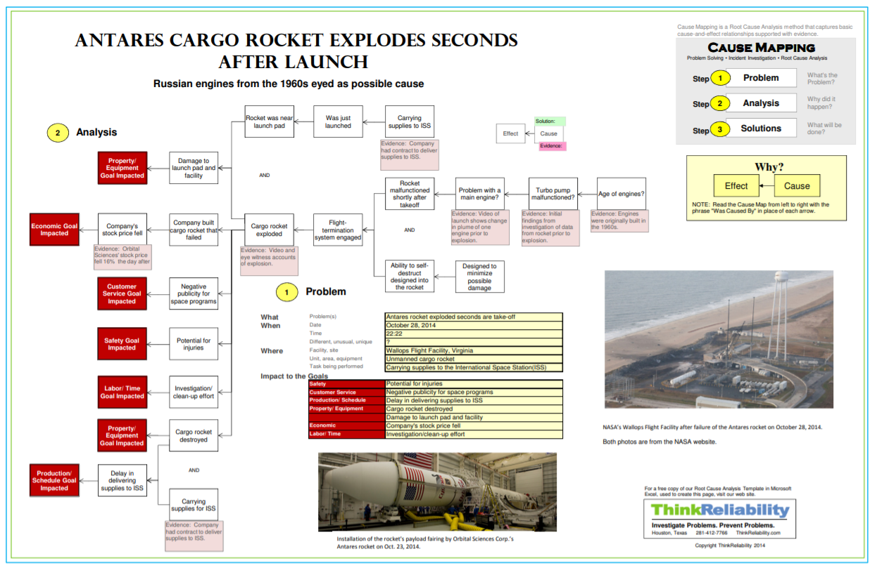
Sample Cause Map

Slide 6
5 Whys
Going back to our original problem, the next question, "Why were there workload issues?“
We can keep asking “Why” until we get to the real root cause
Writing down 5-Whys, shown below, is a great way to start an investigation because it's so simple.

Slide 7
5 Whys – cont.
Why was the report sent late? Because of workload issues.
Why are there workload issues? Because reports take too long to be generated
Why do they take so long? Because there are so many manual adjustments
Why are there so many manual adjustments? Because the process is so manual
Why is the process so manual? Because the team doesn't have the expertise to automate it.

Slide 8
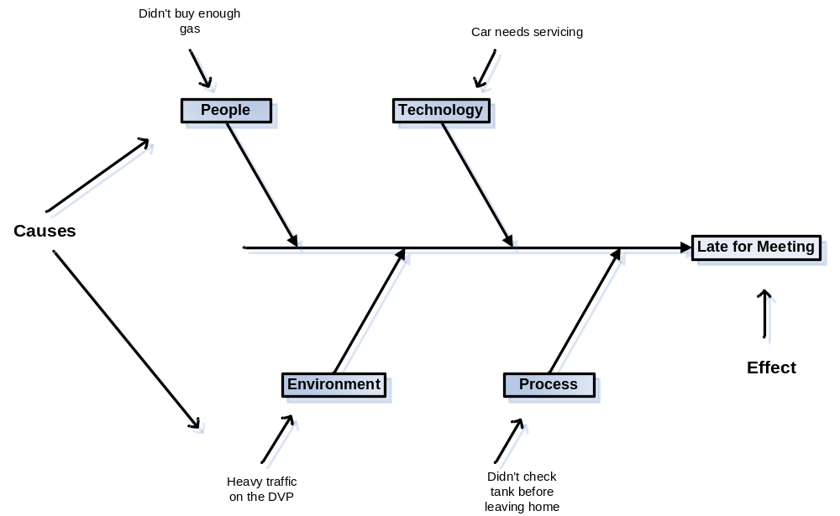
Fishbone Diagrams
Another way to tackle this is through the use of a Fishbone diagram.
A fishbone starts with just one, single problem which doesn't reflect the nature of real world issues.
Mixes causes and possible causes without specifying evidence.
Breaks apart the fundamental cause-and-effect relationships within an issue by grouping the causes into general categories, eg:
  People
  Technology
  Environment
  Process
Example: The Boeing 737 Max debacle…

Slide 9
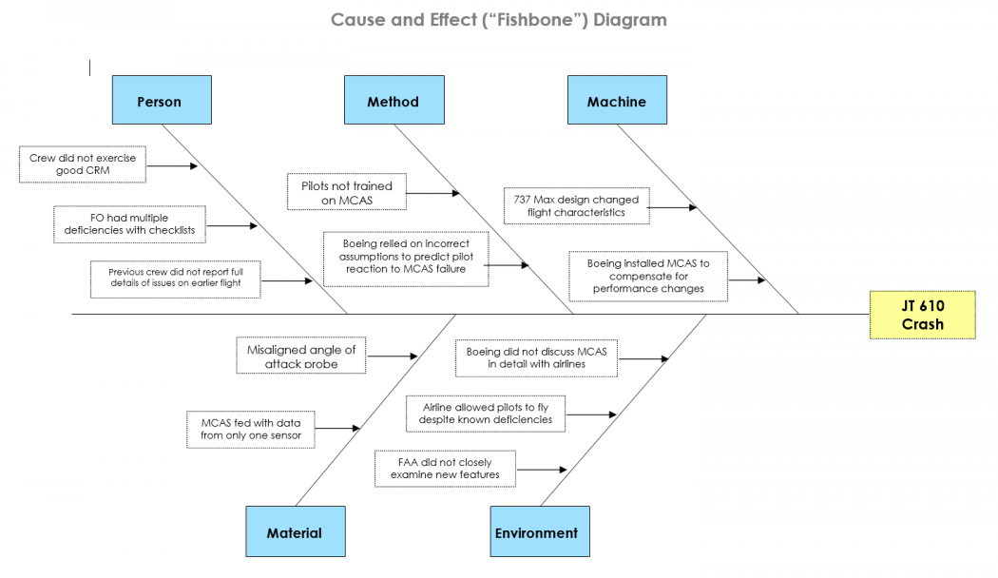
Sample of a Fishbone Diagram

Slide 10

Determining if an RCA is Required
How to determine which situations are candidates for root cause analysis:
Problem has a high level of complexity.
Problem crosses multiple teams or service providers.
Problem is recurring, and/or was part of a previous RCA.
Problem is part of an identified problem trend.
Initial efforts to identify the cause or remedy the problem have not been successful.

Slide 11

In a Nutshell…
Define the problem
Gather data/evidence
Identify issues that contributed to the problem
Find root causes – i.e. if this is removed, will the problem stop?
Develop a solution – recommendations that prevent a repetition of the problem
Implement recommendations/changes
Observe recommended solutions in practice to ensure effectiveness

Slide 12

Benefits of Root Cause Analysis
Recurring problems are fixed
Additional objective analysis can be provided to management
Recommendations that management might not have considered can be made
Previously unknown risks can be identified
Problems are resolved faster and more efficiently
The right people are looking at the issue
Stakeholders will be more satisfied with problem resolution

